Slide 1
Convolutional Neural Network for Traffic Sign Identification
By: Zac Cowan, Matthew Rice, and Brent Reynolds

Slide 2
What's the deal with Image Classification?
We want to use image classification to identify typical United States standard traffic signage.
There are various potential use cases for this specific image classification implementation:
Self-driving vehicles
Driving assist
Traffic regulation system
Monitoring obedience to signage by drivers on a road
The model should be able to perform to the same standard that a licensed driver is held to.

Slide 3
Research
In our research we found a group using a Convolutional Neural Network to do real-time traffic sign classification
They used an architecture containing:
Two convolutional layers
Two max-pooling layers
One dropout layer
Three dense layers
The same paper also described different aspects of identification and scene context important for a full implementation of a self-driving vehicle
Though our focus is on only the traffic sign identification

Slide 4
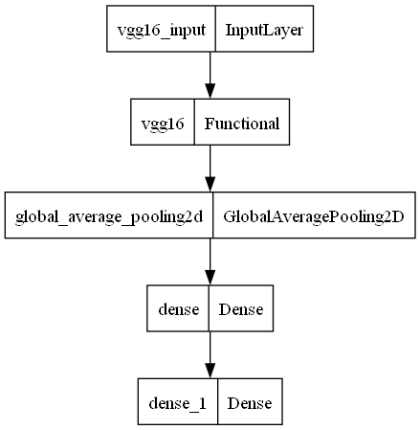
Approach 1: CNN with VGG16 Transfer Learning
CNN with VGG16 Transfer Learning
16-layer architecture
Pretrained from the ImageNet database
Multiple Convolution, Max Pooling, and Connected Layers (Dense Layers).
Benefits
Model trained on very large datasets
Refined layers for optimal training

Slide 5
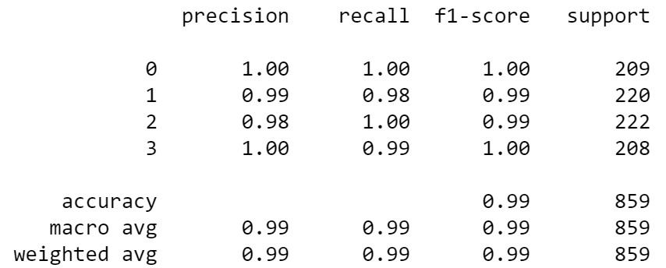
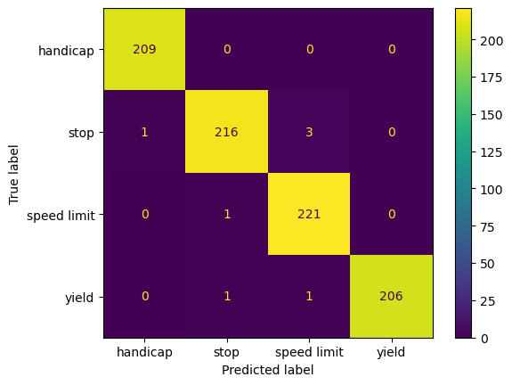
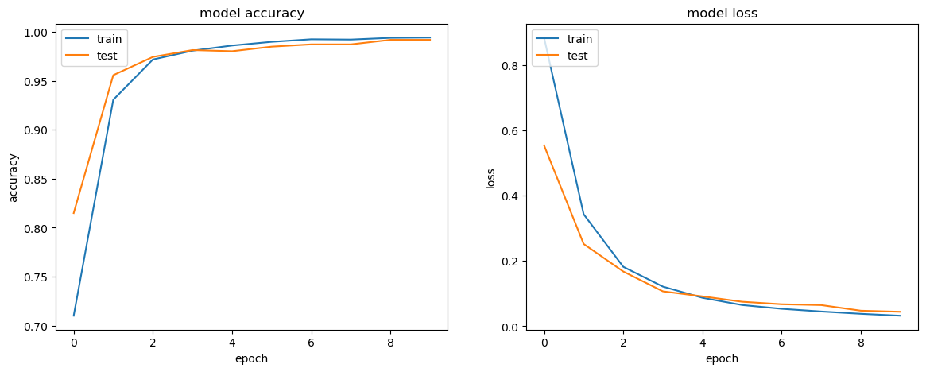
Results 1: CNN with VGG16 Transfer Learning

Slide 6
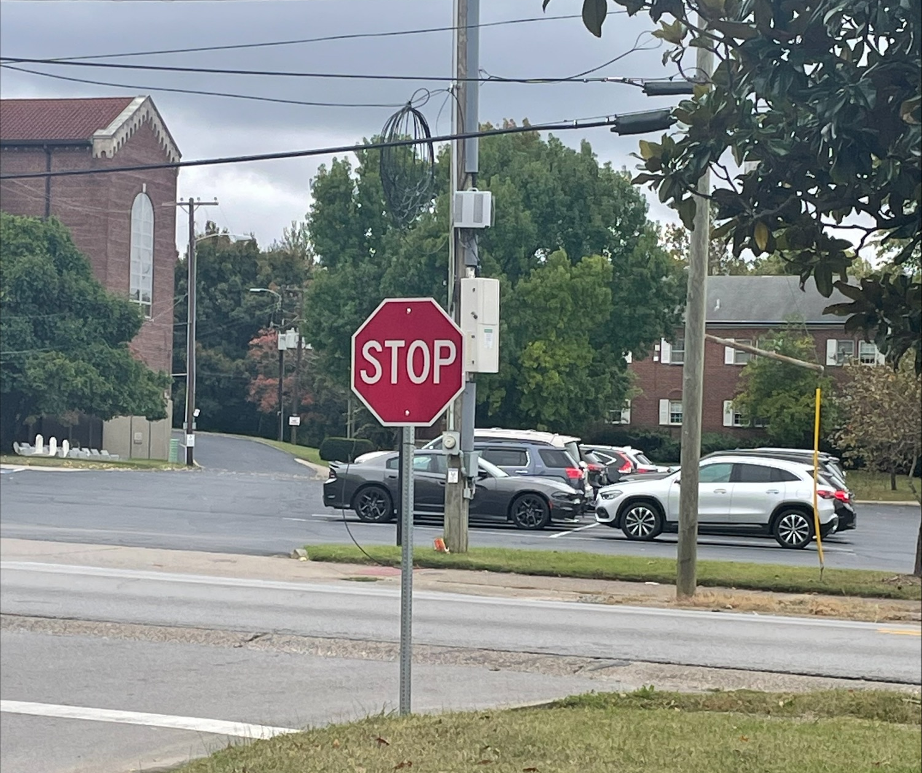
Approach 1: Test Cases
Prediction:
Stop Sign
Prediction Time:
123ms/step

Slide 7
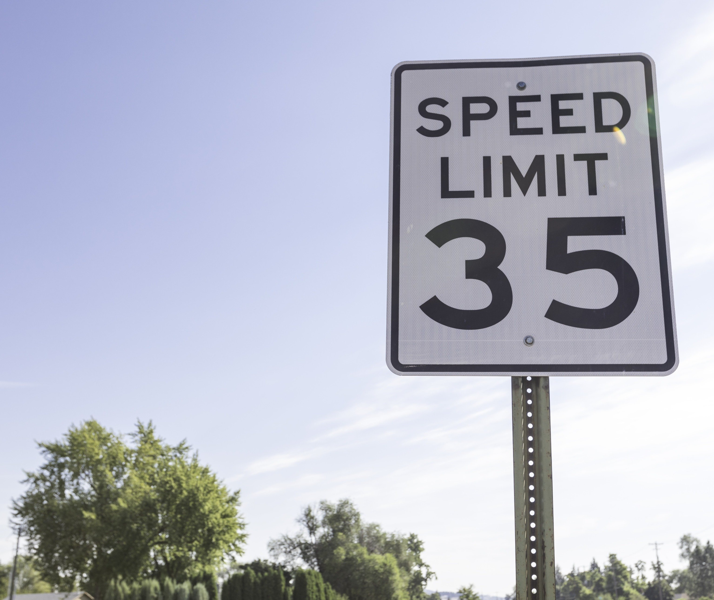
Approach 1: Test Cases
Prediction:
Speed Limit Sign
Prediction Time:
284ms/step

Slide 8
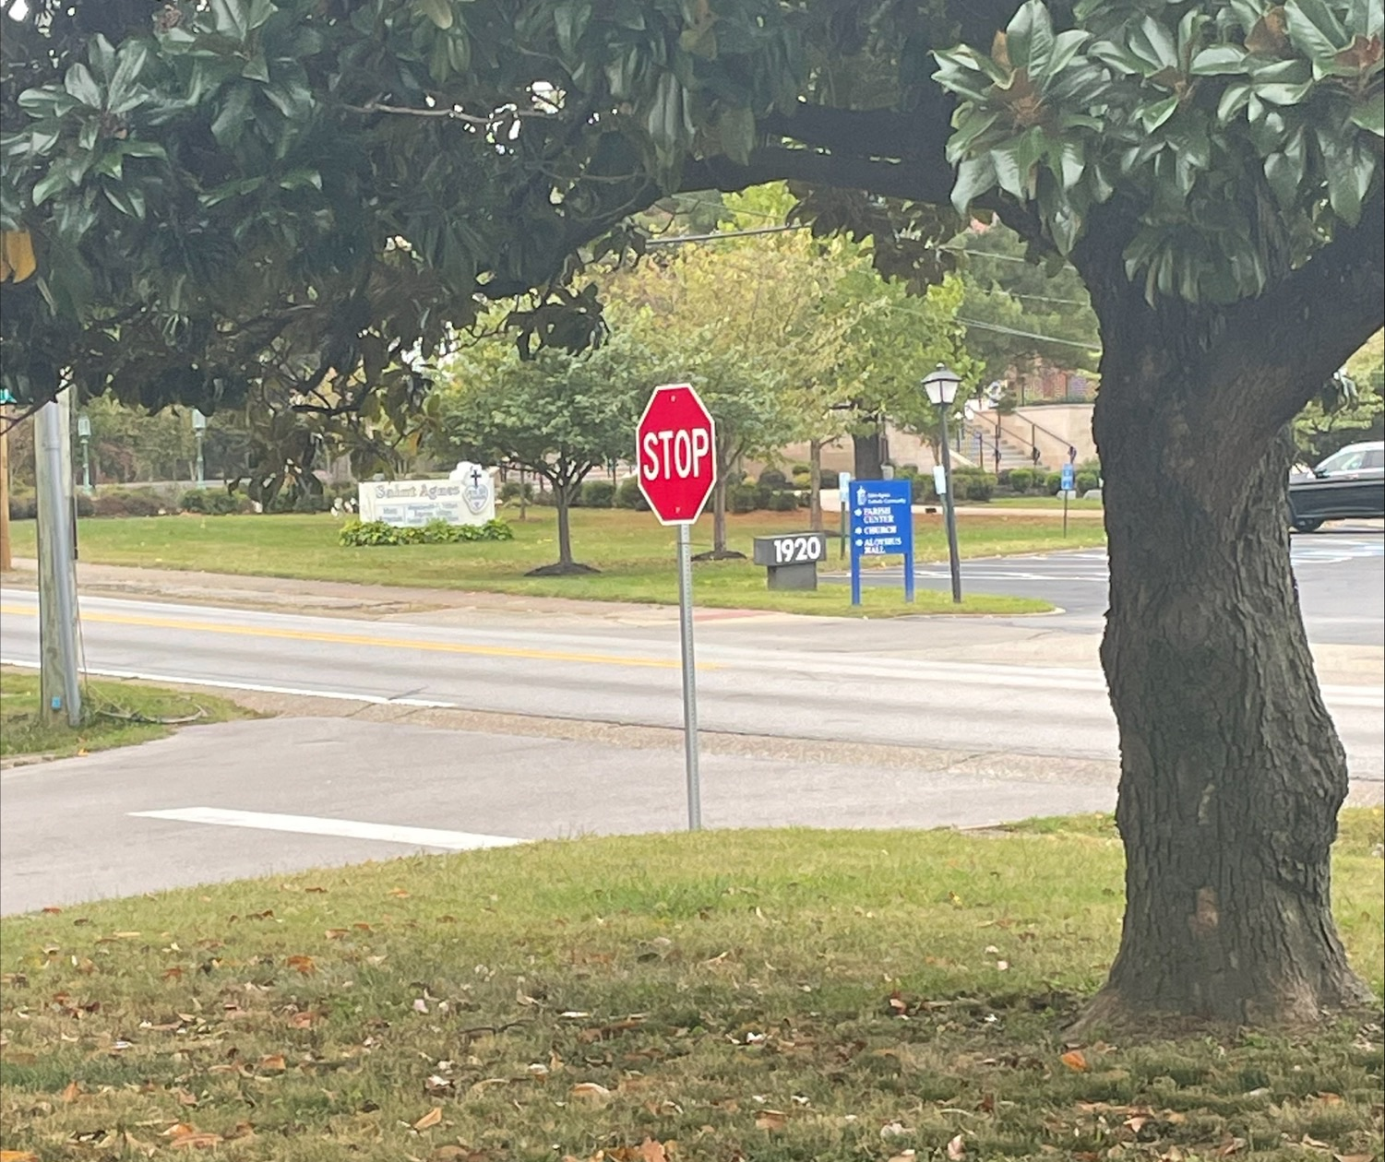
Approach 1: Test Cases
Prediction:
Yield Sign
Observations and Notes:
Foreground elements and harsh angle seem to throw off the prediction in this case.
Cropping the image to emphasize the stop sign resulted in a correct prediction.

Slide 9
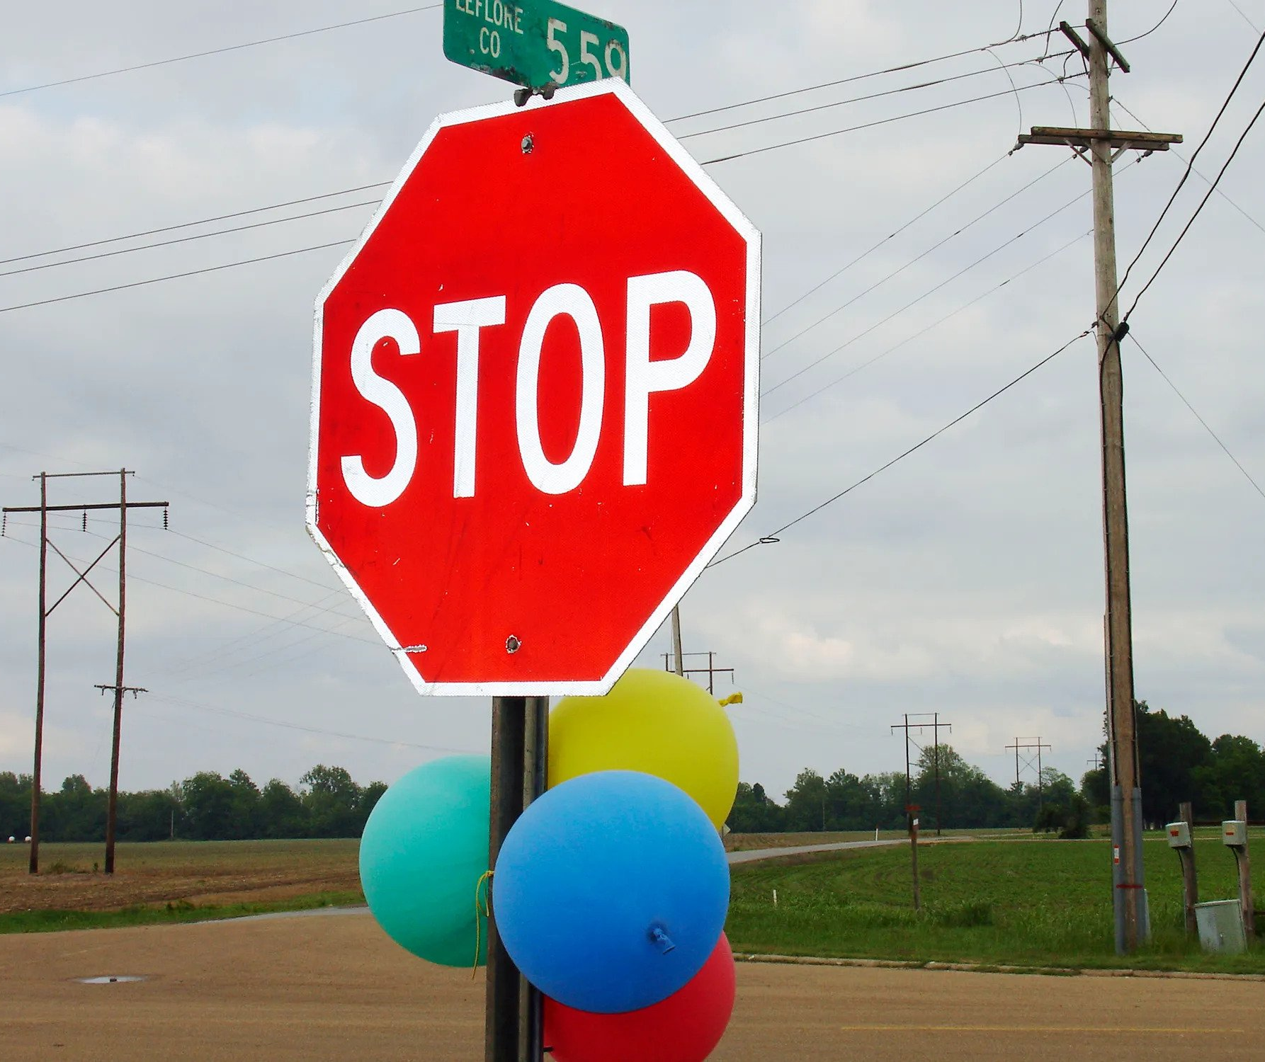
Approach 1: Test Cases
Prediction:
Stop Sign
Prediction Time:
127ms/step
Observations:
The colorful balloons did not throw off classification.

Slide 10

Approach 2: CNN with VGG19 Transfer Learning
CNN with VGG19 Transfer Learning
19-layer architecture
Pretrained from the ImageNet database
Multiple Convolution, Max Pooling, and Connected Layers (Dense Layers).
Benefits
Model trained on very large datasets
Refined layers for optimal training

Slide 11
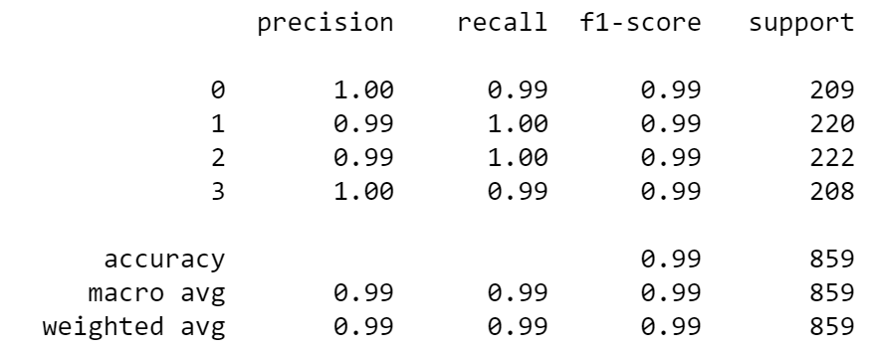
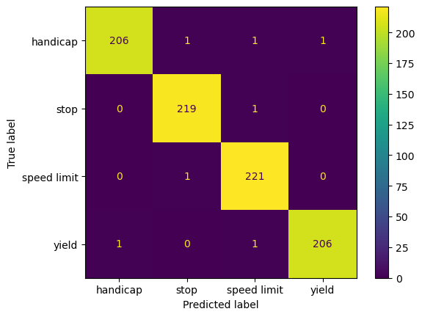
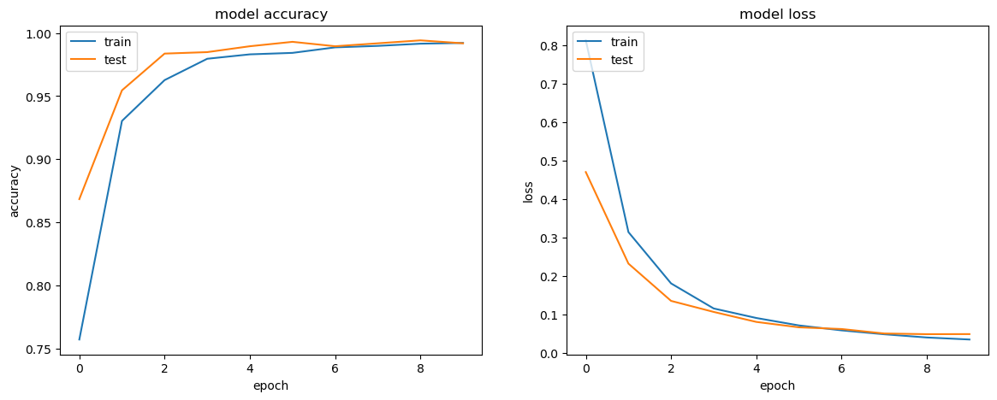
Results 2: CNN with VGG19 Transfer Learning

Slide 12
Approach 3: CNN without Transfer Learning
Our models
19-layer architecture
One trained with 10 Epochs
One trained with 3 Epochs
3 Convolution Layers, 3 Max Pooling Layers, and 3 Dense Layers

Slide 13
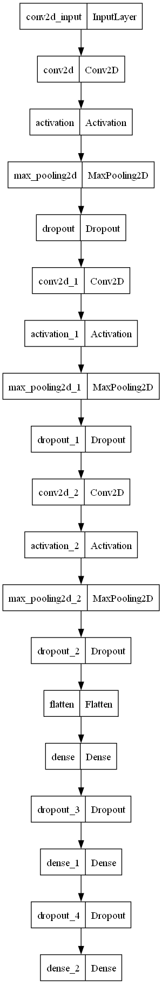
Approach 3: CNN without Transfer Learning

Slide 14
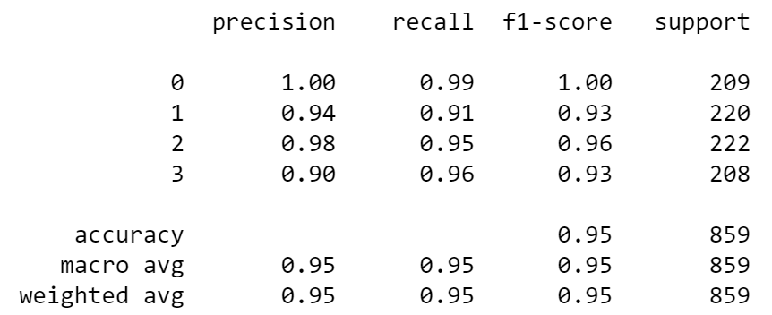
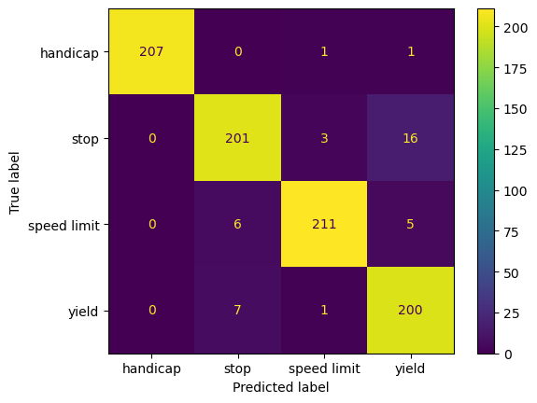
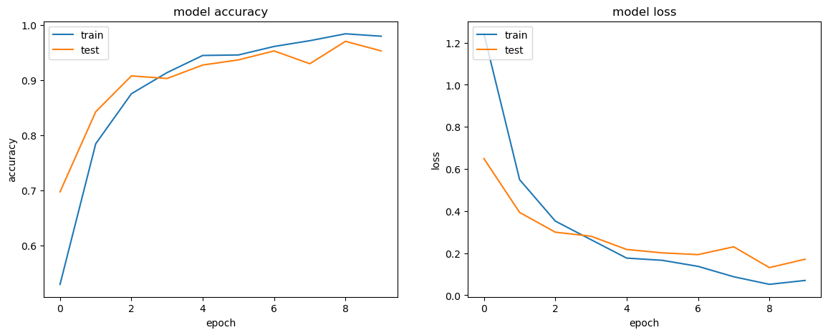
Results 3: CNN no Transfer Learning with 10 Epochs

Slide 15
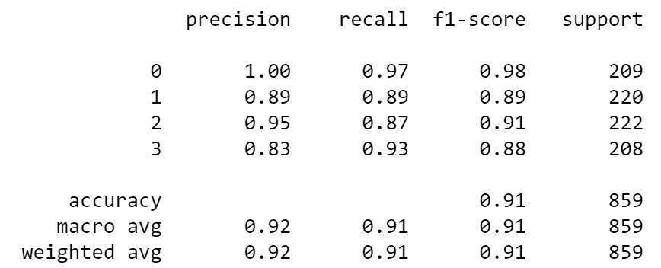
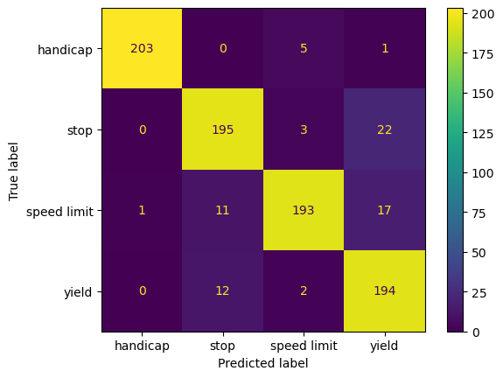
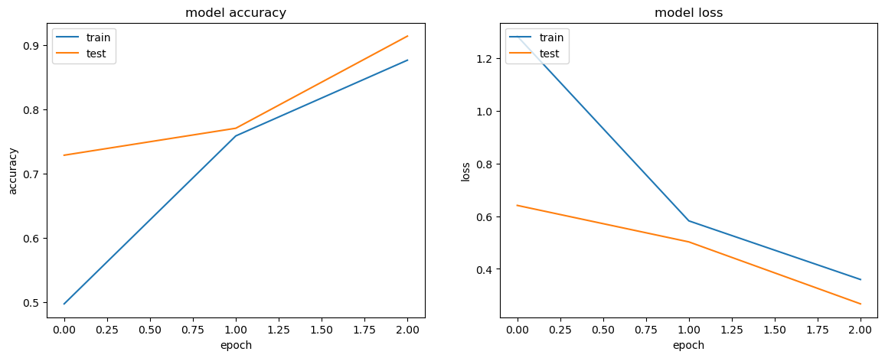
Results 3: CNN no Transfer Learning with 3 Epochs

Slide 16
Our Challenges and Potential Solutions
Broad range of inclusion in dataset could lead to less accurate classification
For Example: There are various types of yield signs: red, yellow, "yield," and "yield ahead"
The convolutions of a CNN model do a good job at averaging these variations, but a more consistent model could be developed to distinguish between these various subsets of signage.
Harsh angles and large foreground elements can throw off predictions.
More images of these difficult cases could be added to the data set to increase accuracy of the model.
Drones could serve useful in collection of images with these difficult to classify environments.

Slide 17
Our Challenges and Potential Solutions
Images in the dataset where our target feature was a small percentage of the overall image may have thrown off the data.
Images with too many extra features could be cropped or thrown out to make the model more accurate.

Slide 18
Conclusion
Data collection is a delicate process. It is not as simple as collecting all images of a given search category online.
In our collection process, we had to weed out many images that were auto downloaded as part of a search.
In general, for our specific application, the VGG16 and VGG19 ImageNet pretrained models performed better than the "in-house" architecture.
CNN Image classification alone is surely a potential solution traffic sign identification in autonomous vehicles but fails to be able to classify in cases where multiple signs are present or similar features may "trick" the model into detecting a sign that does not exist.

Slide 19
References
Aszemi, N. M., & Dominic, P. D. D. (2021). Hyperparameter Optimization in Convolutional Neural Network using Genetic Algorithms. International Journal of Advanced Computer Science and Applications, 10(6). https://doi.org/10.14569/ijacsa.2019.0100638
Fujiyoshi, H., Hirakawa, T., & Yamashita, T. (2019). Deep learning-based image recognition for autonomous driving. IATSS Research, 43(4). https://doi.org/10.1016/j.iatssr.2019.11.008
Ni, J., Chen, Y., Chen, Y., Zhu, J., Ali, D., & Cao, W. (2020). A Survey on Theories and Applications for Self-Driving Cars Based on Deep Learning Methods. Applied Sciences, 10(8), 2749. MDPI AG. Retrieved from http://dx.doi.org/10.3390/app10082749

